Slide 1
The Three Musketeers
RFID STUDENT CARD READER
Student Number | Name & Surname
222144408 | Emmanuel Posholi Posholi
221805486 | Sisonke Mhlana
222353775 | Shezi Minathi

Slide 2
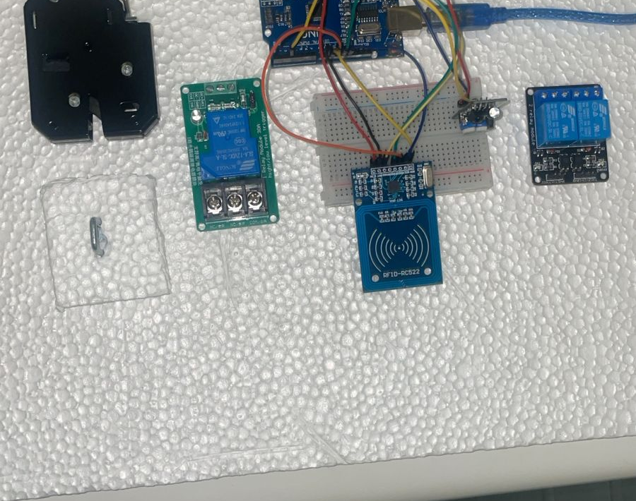
Introduction
This document outlines the development process of integrating a DFRobot Heavy Duty Electromagnetic Lock (12V Solenoid) with an Arduino Uno microcontroller. The project successfully achieved control of the lock via a relay module. However, a critical lesson was learned when the lock was accidentally burned due to excessive power-on time.

Slide 3
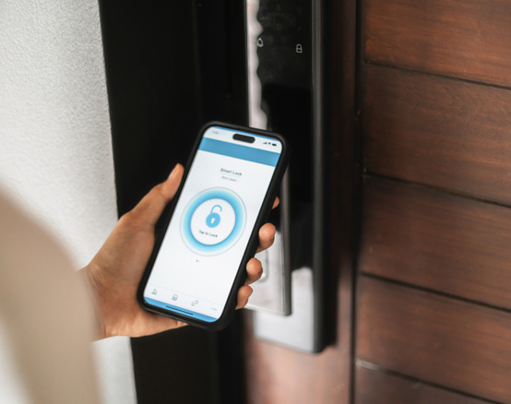
Problem Statement & Solution
Problem - Making physical student cards wastes time, money, ink, and paper. Students must stand in long queues to get a new card or replacement. The current system is inefficient and outdated.
Solution - A digital student ID system using NFC technology. Students would sign up on a university app and receive a digital student card on their phone - similar to how medical aid apps work. This digital card would be used to open doors and gates via NFC.
Due to component limitations, our prototype uses a physical student card or tag instead of a phone. However, the working system proves the concept. Future implementation with the university app would eliminate physical cards entirely.

Slide 4
Problems Faced and Solutions
Problem 1: Arduino Not Reading / Not Responding
Description:
The Arduino Uno was not being recognized by the computer when connected via USB
Code would not upload
No serial communication could be established
Solution Applied:
Tested multiple USB cables to ensure data transfer capability
Reinstalled CH340/Arduino drivers
Selected the correct COM port and board (Arduino Uno) in Arduino IDE
Restarted the Arduino IDE and computer
Status: Resolved

Slide 5
Problems Faced and Solutions
Problem 2: No Power Supply Available for the Lock
Description:
The 12V solenoid lock requires 12V DC at approximately 1.5A
Initially, no suitable 12V power source was available
The Arduino's 5V pin cannot power the lock (voltage too low, current insufficient)
Final Solution Applied:
A DStv 12V AC adapter was used as the power supply
The adapter successfully provided the required 12V DC power to the relay module and lock
Status: Partially Resolved

Slide 6
Problems Faced and Solutions
Problem 3: Using a DStv 12V AC Adapter as Power Supply
Description:
A DStv decoder power adapter was available (commonly found in South African households)
The adapter needed to be verified for output type (AC vs DC) and current rating
Investigation Result:
Outcome:
The DStv adapter was successfully used to power the relay and lock
It provided sufficient voltage (12V DC) for the solenoid to activate
Status: Resolved and successfully used
Adapter Label | Output Type | Usable?
12V DC | Direct Current | Yes - provided the lock was not left on too long

Slide 7
Problems Faced and Solutions
Problem 4: Lock Got Burned (Accidental Damage)
Description:
During testing, the 12V solenoid lock was accidentally connected to power for more than 5 seconds
This caused the copper coil inside the lock to overheat and burn out
The lock is now permanently damaged and will not function
Why This Happened:
The lock is designed for short pulses only (typically 0.5 to 5 seconds maximum)
Leaving 12V applied continuously causes the coil to overheat rapidly
There is no internal thermal protection or automatic shutoff

Slide 8
What Was Successfully Demonstrated
Component | Specification | Status
Arduino Uno | 5V logic, ATMega328P | Working
Electromagnetic Lock | DFRobot Heavy Duty 12V Solenoid | Burned
Relay Module | SRD-05VDC-SL-C (2-channel) | Working
Power Supply | DStv 12V DC adapter | Working
Connecting Wires | Jumper wires, stripped wires | Working
Demonstration | Success | Evidence
Arduino code uploads correctly | Yes | IDE shows successful upload
Relay module receives signal | Yes | Red light appears
Relay switches power from DStv adapter | Yes | Multimeter shows voltage switching
Lock receives power at correct time | Yes | Lock worked initially before burning
Control logic (pulse timing) | Yes | Code executed as intended

Slide 9
Lessons Learned
Solenoid locks are pulse-operated devices - they must only receive power for short bursts (5 seconds or less)
A burned lock does not mean the system failed - the Arduino, relay, and power supply can still be fully functional
Always verify the power-on time in code before leaving a test running unattended
The relay clicking is proof of successful control - even if the lock no longer moves
A DStv 12V adapter works perfectly as a power supply for this project, provided it outputs DC (not AC)
Face-to-face campus meetings were essential for hands-on wiring and troubleshooting
WhatsApp served as an effective remote communication tool for sharing progress and problems

Slide 10
Conclusion
The project successfully demonstrated Arduino-controlled operation of a relay module using a DStv 12V power supply. The relay clicked, the code executed, and the lock initially activated as intended.
However, the lock was accidentally burned due to being powered for more than 5 seconds, which exceeds the solenoid's design limits.
This failure was user error, not a design flaw. All other components remain fully functional, proving that the control system works correctly. The experience reinforced the critical importance of respecting manufacturer specifications for pulse-operated components.

